Slide 1
PCS Talent Identification program (PCS-TIP)
Parent information meeting
Presented by: Valerie Santos

Slide 2
Pcs district strategic plan
Strategic Goal #2: Ensure curriculum, instruction, and assessment are designed and delivered with a focus on content rigor, student engagement, and continuous improvement of academic achievement.​
Action ITEM: Implement a data analysis and action planning process for the SAT Suite of Assessments that includes monitoring each school’s fidelity to their action plan that begins with grade 7 TIP participation and culminates with grade 11-12 SAT School Day.

Slide 3
PCS Talent Identification Program
What is the purpose of this program?
Identification of and enrichment for academically talented 7th grade students
Assist students and parents/guardians to develop college-preparatory academic plans for 8th grade and beyond into high school
Provide valuable practice to students before they take the PSAT and SAT in high school to qualify for National Merit Scholarship opportunities and college entrance

Slide 4
The Challenge to Raise the Bar
The 21st century global economy is fast-paced and changeable.
People need a habit of lifelong learning to flourish in this information age. The best way to succeed and thrive as an adult is to challenge oneself to rise to a high level of academic excellence now. Students can best accomplish this by taking challenging high school courses and working hard to perform well in these courses.
THE SAT PROVIDES A TRUSTED, GLOBALLY RECOGNIZED INDICATOR OF ACADEMIC READINESS FOR COLLEGE.
SAT IS A BRIDGE BETWEEN THE HARD WORK A STUDENT HAS ALREADY DONE AND THE COLLEGE THAT IS THE BEST FIT FOR THE FUTURE THE STUDENT IS ABOUT TO CREATE.

Slide 5
Why Take the SAT?
As the nation’s most widely used college admission test, the SAT is the first step toward higher education for students of all backgrounds.
It’s taken by more than two million students every year and is accepted by virtually all colleges and universities.

Slide 6
What are the benefits of participating?
Students are selected for PCS TIP because they have scored at higher levels on a normed, standardized achievement test.
Once the students have individual SAT scores, each student can be advised about his/her current skills in mathematics and language arts.
Using the SAT score reports, school administrators and teachers are able to adjust course content and instructional pacing to challenge the students, allowing bright students more opportunities to realize their academic potential.

Slide 7
The sat is
ACCEPTED BY ALMOST ALL U.S. COLLEGES
Typically taken by students during the spring of their junior year and the fall of their senior year
powerful IN combination WITH HS GPA
Used together, there’s nothing better at predicting potential college success

Slide 8
Quick Facts about the SAT
4 parts: Reading, Writing and Language and Math, plus an optional SAT Essay that is not included in the TIP SAT)
400–1600 score scale
3 hours (add 50 minutes if the essay is included)
4 answer choices for multiple choice questions
8 college application fee waivers for an 11th or 12th grade student who uses an SAT fee waiver

Slide 9
Who did we identify?
The TOP 15% of students within each school’s 7th grade class as measured by their combined performance on the 2019 Florida Standards Assessments for ELA & Math
Other 7th grade students from under-represented groups (minority or low income) who are academically talented

Slide 10
What are the steps to be a pcs TIP student?
Students return the commitment form and registration to tip coordinator between October 7-18, 2019
Parents receive the registration packet to register their child to take the SAT at a participating middle school on DECEMBER 7, 2019
Parent submit the registration form to the TIP Coordinator at their child’s middle school with a check made payable to the school on or before October 18 to register their child for the DECEMBER SAT
Students receive test preparation for the reading and mathematics portions of the SAT in the TIP Tutorials
Students participate in the DECEMBER 7, 2019 SAT
PARENTS ATTEND THE SAT INFORMAtiON SESSION ON DECEMBER 7, 2019 AT THE SAT TEST SITE & THEN ATTEND A SCHEDULING INFO SESSION IN JANUARY 2020
Students have the opportunity to engage in college readiness and STEM experiences through a PCS STEM Camp during Summer 2020

Slide 11
2019-2020 TIP SAT Date/Deadline/LOCATIONs
SAT Date | PCS Registration Deadline (allows for time to verify accuracy)
December 7, 2019 | October 18, 2019
The following sites are available only to PCS 7th grade students:
East Lake Middle School – Test Center Code: 10733
John Hopkins Middle School – Test Center Code: 10066
Oak Grove Middle School – Test Center Code: 10065
Meadowlawn Middle School – Test Center Code: 10124
Safety Harbor Middle School – Test Center Code: 10063
Seminole Middle School – Test Center Code: 10480

Slide 12
SAT Registration
Due to Internet privacy laws, students younger than 13 years of age cannot register online. To register for the SAT, students must obtain a registration envelope which contains the registration guide and a paper registration form.
Parents and students must complete the form, and submit it to TIP COORDINATOR NAME with a check made payable to SCHOOL NAME Middle School.
TIP Coordinators will collect registration forms and payments, review registration forms for accuracy, collaborate with bookkeepers to deposit the payments and then submit all registration forms to the College Board with the Bulk Transmittal form and one payment from the school.

Slide 13
SAT Registration fee
College Board’s SAT Registration fee is $49.50
Parents are responsible for the testing fee. If financial assistance is needed, schools may contact the advanced studies office for assistance with the registration fee

Slide 14
Photo Requirements
Students who are in 8th grade or below at the time of testing are not required to provide a photo identification for registration purposes
Students must have their admission ticket and a photo identification for admission to testing – a screen print from Focus including their school photo is acceptable as a photo ID for 7th grade students

Slide 15
Scores
Scores for the December 7, 2019 SAT will be available beginning on January 18, 2020.
See sample score report to the right.

Slide 16
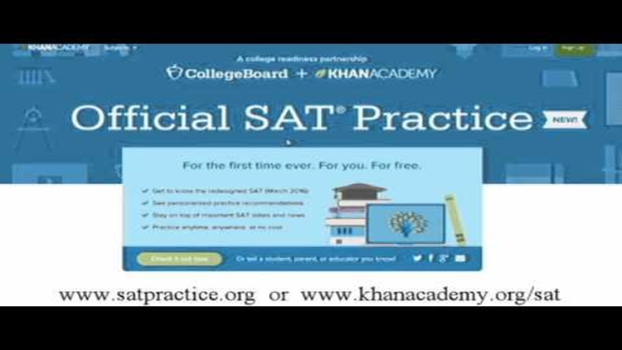
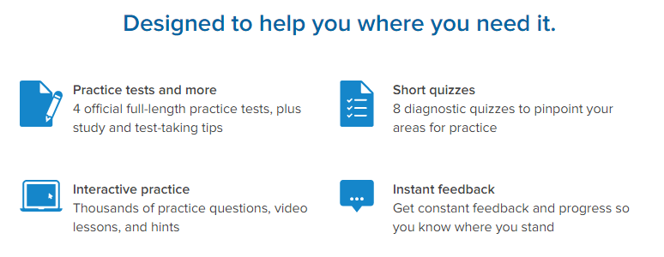
SAT Practice
SATpractice.org

Slide 17
Khan Academy
Our mission is to provide a free, world‑class education for anyone, anywhere.
A personalized learning resource for all ages
Khan Academy offers practice exercises, instructional videos, and a personalized learning dashboard that empower learners to study at their own pace in and outside of the classroom. We tackle math, science, computer programming, history, art history, economics, and more. Our math missions guide learners from kindergarten to calculus using state-of-the-art, adaptive technology that identifies strengths and learning gaps..

Slide 18
Other things to consider
Tutorial schedule
Brief overview of Tutorial Program (logistics)
Wednesday Mornings 7-7:40 First meeting in Media Center
10/2, 10/9, 10/16, 10/23, 10/30, 11/6, 11/13, 11/20, 12/4
Transportation to and from the optional tutorial sessions is the responsibility of the parent/guardian

Slide 19
What Questions or Concerns do you have?

